Slide 1
What Lawyers Wish You Knew About Disaster Legal Aid

Slide 2
Speakers
Shrushti Kothari
Project Manager of National Disaster Resources and Content
Lone Star Legal Aid
Stephanie Duke
Equal Justice Works Disaster Resilience Fellow
Disability Rights Texas

Slide 3
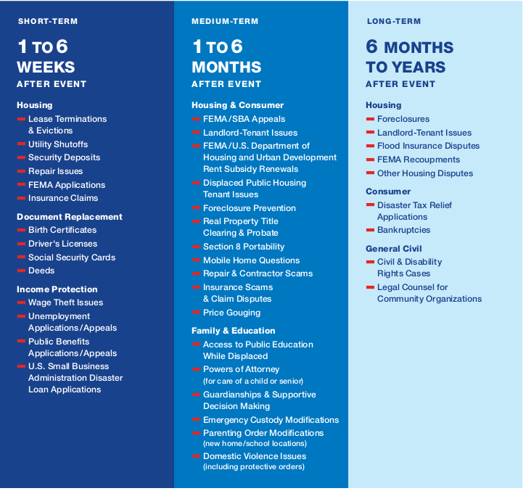
Legal Issues

Slide 4
Where to turn for help
Legal Aid Organizations
Disability Rights Texas
Online Resources developed for Self Represented Litigants

Slide 5
Disability Rights Texas
Mission: DRTx is the Protection and Advocacy Agency (“P&A”) for the state of Texas, we work to ensure every Texan with a disability rights are upheld and are provided equitable opportunities within society.
Operate State wide
Legal issue must have a nexus with disability
No income restrictions
Apply online DRTx intake or call 1-800-252-9108

Slide 6
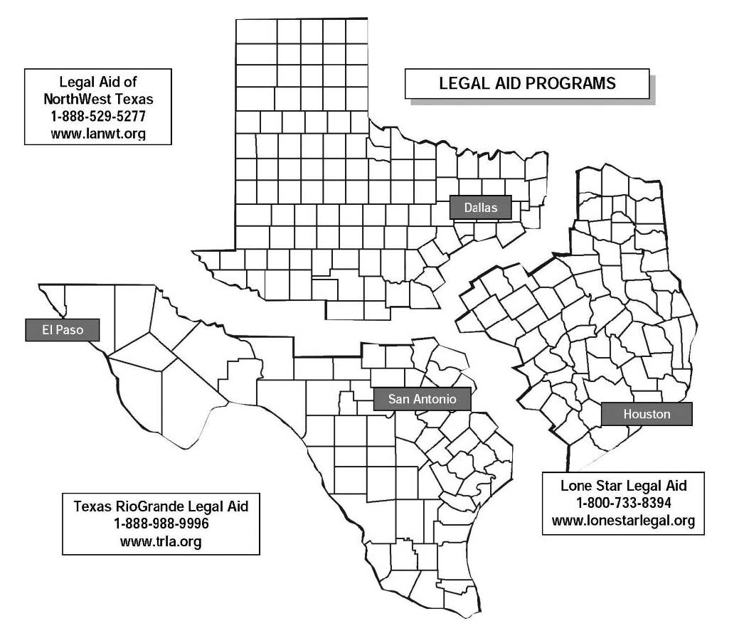
Lone Star Legal Aid
Mission: To protect and advance civil legal rights of low-income Texans by providing free advocacy, legal representation and community education that ensures equal access to justice
LSLA serves 72 counties in SE Texas and 4 in Arkansas
Apply online or call (713) 652 0077

Slide 7
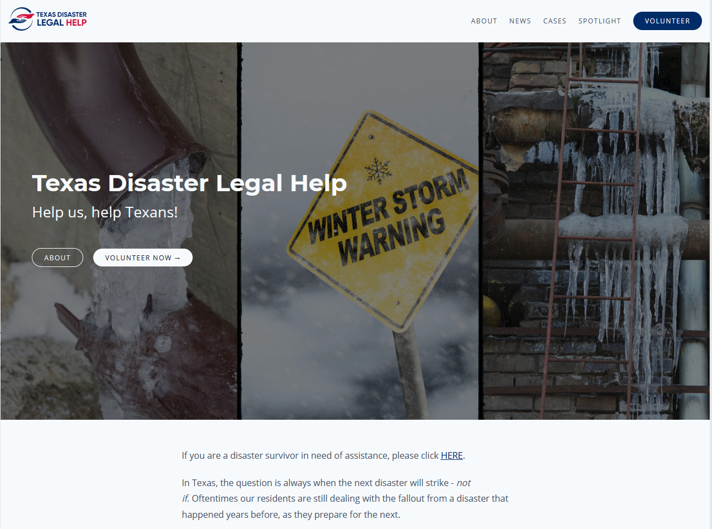
Texas Disaster Legal Help (TDLH)

Slide 8
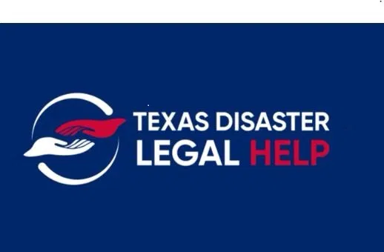
Texas Disaster Legal Help (TDLH)
Collaboration between LSLA, TRLA, & LANWT to improve mobilization of Pro Bono volunteers after a disaster.
Guided Navigation for disaster survivors.
Pro Bono Portal dedicated to connecting pro bono volunteers to educational materials, training, and volunteer opportunities.
Volunteers can view tailored resources, review and accept cases statewide, sign up for ongoing training opportunities, track case time and CLE credits, access helpful templates, and conduct other case work.

Slide 9
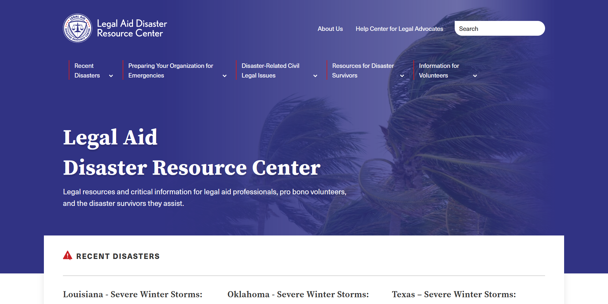
Legal Aid Disaster Resource Center (LADRC)

Slide 10
Legal Aid Disaster Resource Center (LADRC)
Legal Aid Disaster Resource Center
Started by the LSC after recommendations by 2018 Disaster Task Force.
Went online in December of 2020
Includes resources for attorneys, organizations, case managers, and disaster survivors.

Slide 11
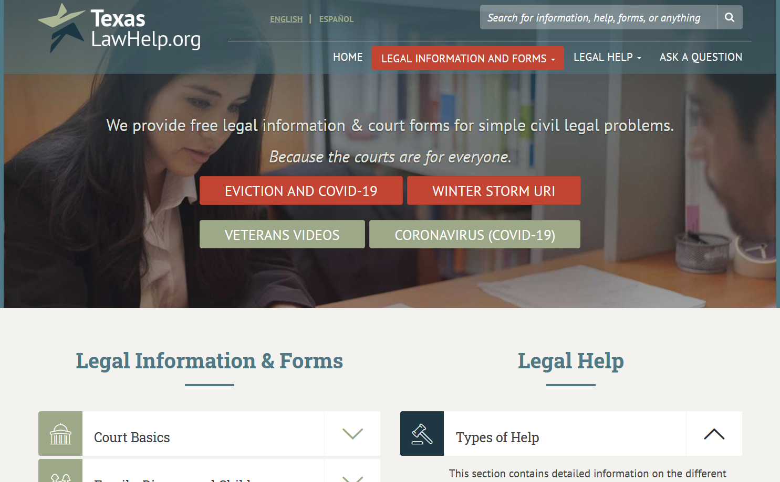
Texas Law Help (TLH)

Slide 12
Texas Law Help (TLH)
TexasLawHelp.org is a website dedicated to providing free, reliable legal information to low-income Texans.
It is part of a broader effort within the national legal aid community to use technology, specifically the Internet, to enhance and expand the delivery of legal aid.

Slide 13
Disaster Assistance & Recovery Tool (DART)
The Disaster Assistance & Recovery Tool (DART) is an innovative web-based interview and referral application to help community organizations identify common disaster legal needs faced by Hurricane Harvey and other disaster survivors.
This app may offer to connect the survivor with Lone Star Legal Aid, a nonprofit legal service provider.
It was created in partnership with Lone Star Legal Aid and Pro Bono Net, and funded by the Rebuild Texas Fund.

Slide 14
ABA-YLD DLS Hotline
American Bar Association - Young Lawyers Division Disaster Legal Services Hotline
Set up thru a partnership between the ABA and FEMA.
Takes referrals and directs them to the appropriate legal aid agencies.
Winter Storm Uri Disaster Legal Services Hotline: 1 (800) 504-7030

Slide 15
Disability resources in disasters
Disability Chapter in Disaster Manual-State Bar of Texas, Disability rights in Disasters
Partnership for Inclusive Disaster Strategies 1-800-626-4917
EJW training videos videos -EJW disaster resilience videos
DRTx:
DRTx created self help tools which address housing needs under Fair Housing Act and special education services under IDEA and consumer protections.
Housing: Housing letter generator
Education: TEA complaint for denial of services IDEA services letter generator
Consumer issue: Consumer issue letter generator

Slide 16
Questions?
Shrushti Kothari
Project Manager of National Disaster Resources and Content
Lone Star Legal Aid
skothari@lonestarlegal.org
Stephanie Duke
Equal Justice Works Disaster Resilience Fellow
Disability Rights Texas
sduke@disabilityrightstx.org

