Slide 1
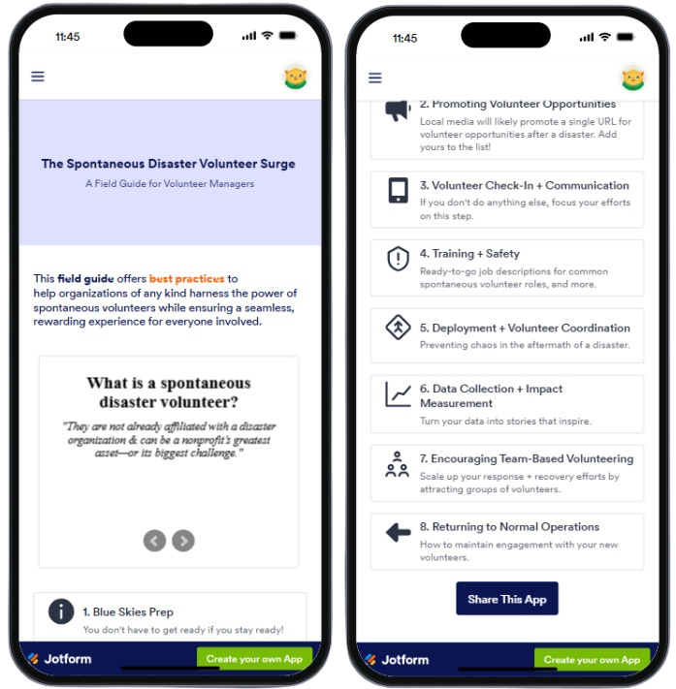

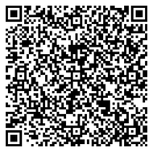
The Spontaneous Disaster Volunteer Surge:
A Field Guide for Volunteer Managers
1
Scan to download the mobile app
Add to your home screen
Share with 1 person
Deliver a volunteer experience they’ll never stop talking about!
2
3
4
https://app.jotform.com/251037030755146
Notes:
TALKING POINTS:
Anyone who leads spontaneous disaster volunteers in any capacity is invited to reference this resource.
This Field Guide was designed and created by a group of Houston-area volunteer managers in 2025 and is maintained by Texas Gulf Coast Regional VOAD.
It's an easy read - only bulleted lists and videos that are less than 3 minutes long.
The PURPOSE of the Field Guide is to provide best practices that help organizations of any kind harness the power of spontaneous volunteers while ensuring a seamless, rewarding experience for everyone involved.
The guide itself is a mobile app that can be accessed at any time, anywhere after it's added to your phone.
Scan the QR code to download and add it to the home screen of your smartphone.
SHARE SHARE SHARE this resource with every volunteer manager, coordinator, director you know!
‹#›

