Slide 1
VOLUNTEER
COORDINATION
26 FEB 2025

Slide 2
Agenda
Welcome and Introductions
Steering Committee
Presentation to Houston Ready Roundtable (attached)
  Review the overall design and reach/confirm a consensus on moving forward.
  Updates / Work in Process
    Job descriptions (attached)
    Volunteer Houston Redesign

Slide 3
Agenda
Divide and conquer!
  Establish work teams, scopes, deliverables, and schedule for near-term implementation (May 28th)
Confirm the meeting schedule and modify it as required.
Next Meeting.

Slide 4
Steering Committee
Brooke Campbell, United Way of Greater Houston, GHDA
Gary Flaharty, TGCRVOAD
Jeremy Samuels, Interfaith Ministries
Robert Nnake, Harris County, County Judge's Office
Roman Aguilar, City of Houston, DON
Stephanie Wright, HCOHSEM
Tommy Holstein, Baker Ripley
Trevor Barnet, The Restoration Team

Slide 5
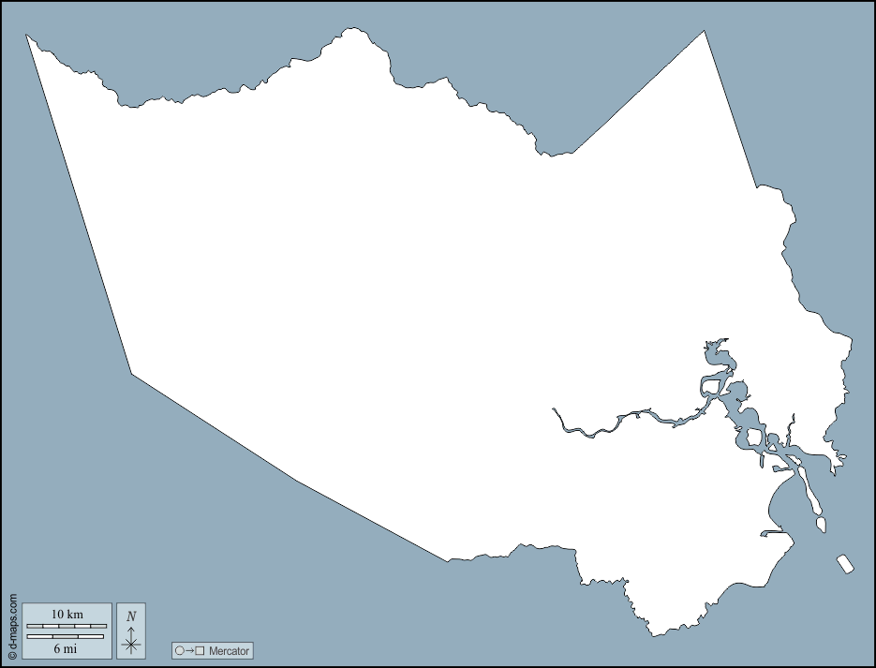

Process Overview
VOADs and NGOs
VOADs and NGOs
Volunteer
Portal
@
Volunteer Houston
Potential Unaffiliated Volunteers
VOADs and NGOs
Jurisdictions
Jurisdictions
Jurisdictions

Slide 6
Goals
Establish Targeted Pools of Potential Unaffiliated Spontaneous Volunteers
Refine the Process for Recruiting, Placing, and Assigning Unaffiliated Volunteers with VOADs, NGOs, and Jurisdictions
GSD & Deliver Great Volunteer Experiences
Build Capacity to Accept Unaffiliated Spontaneous Volunteers in the right locations

Slide 7
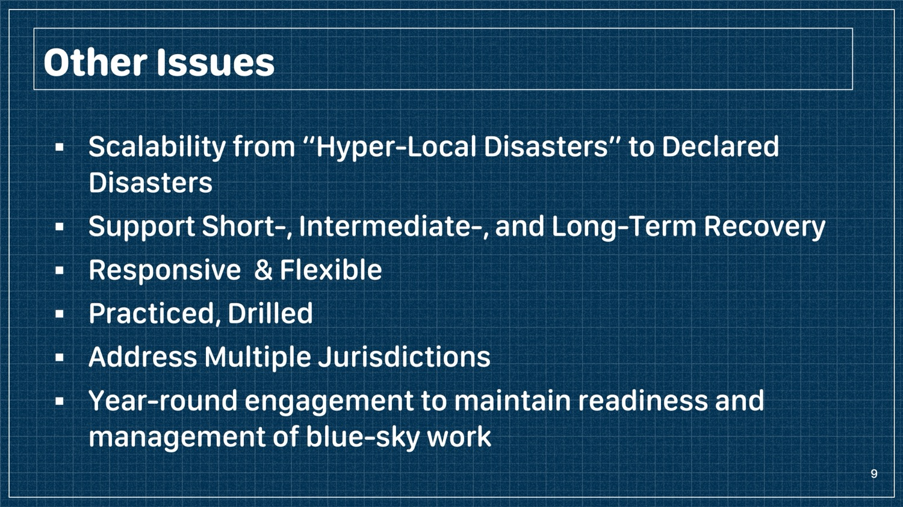
Other Issues
Scalability from “Hyper-Local Disasters” to Declared Disasters
Support Short-, Intermediate-, and Long-Term Recovery
Responsive & Flexible
Practiced, Drilled
Address Multiple Jurisdictions
Year-round engagement to maintain readiness and management of blue-sky work

Slide 8
Goals
Establish Targeted Pools of Potential Unaffiliated Spontaneous Volunteers (Recruitment - Robert)
Refine the Process for Recruiting, Placing, and Assigning Unaffiliated Volunteers with VOADs, NGOs, and Jurisdictions (Portal - Andi)
GSD & Deliver Great Volunteer Experiences ( Volunteers- Brooke)
Build Capacity to Accept Unaffiliated Spontaneous Volunteers in the right locations (Capacity - Gary)

Slide 9
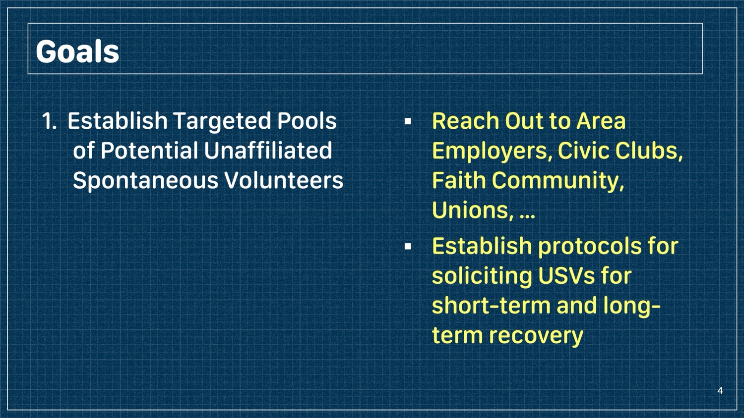
Goals
1. Establish Targeted Pools of Potential Unaffiliated Spontaneous Volunteers
Reach Out to Area Employers, Civic Clubs, Faith Community, Unions, …
Establish protocols for soliciting USVs for short-term and long-term recovery

Slide 10
Discussion
United Way
GHP
Houston Responds
Fraternities & Sororities
Universities
Education
Interfaith Ministries –
Super-Neighborhoods
Using Crisis Cleanup, iSTAT, How to
CERT, MRC

Slide 11
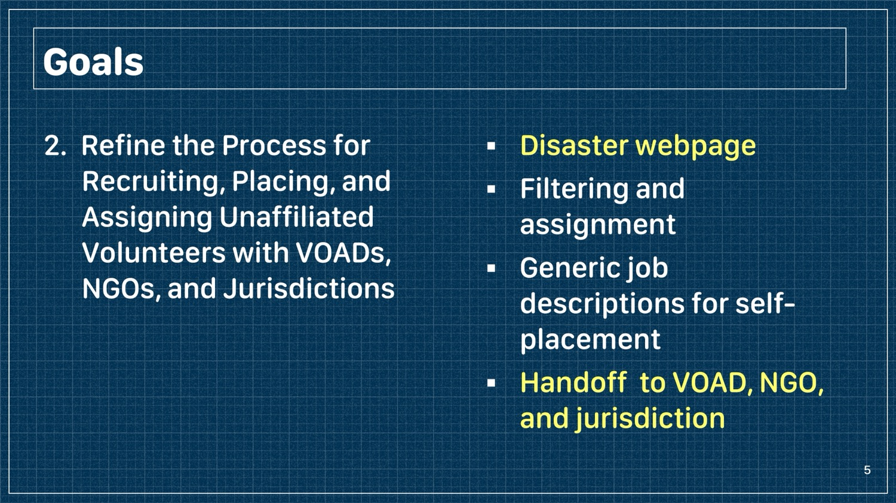
Goals
2. Refine the Process for Recruiting, Placing, and Assigning Unaffiliated Volunteers with VOADs, NGOs, and Jurisdictions
Disaster webpage
Filtering and assignment
Generic job descriptions for self-placement
Handoff to VOAD, NGO, and jurisdiction

Slide 12
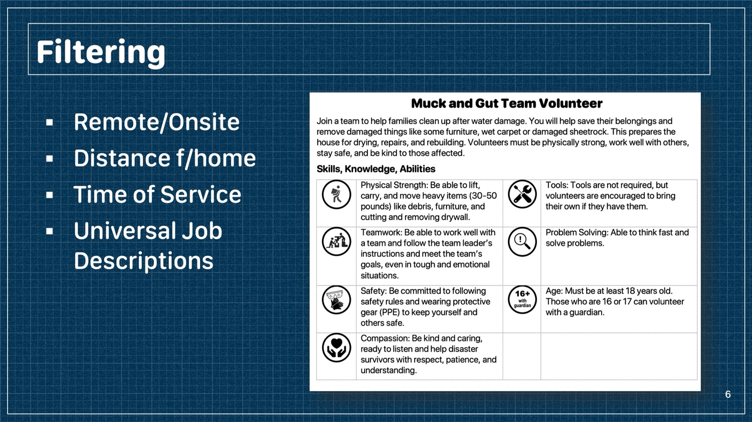
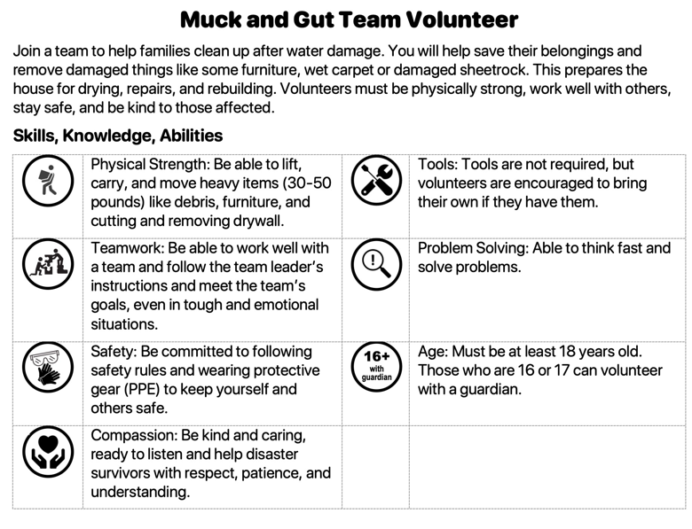
Filtering
Remote/Onsite
Distance f/home
Time of Service
Universal Job
Descriptions

Slide 13
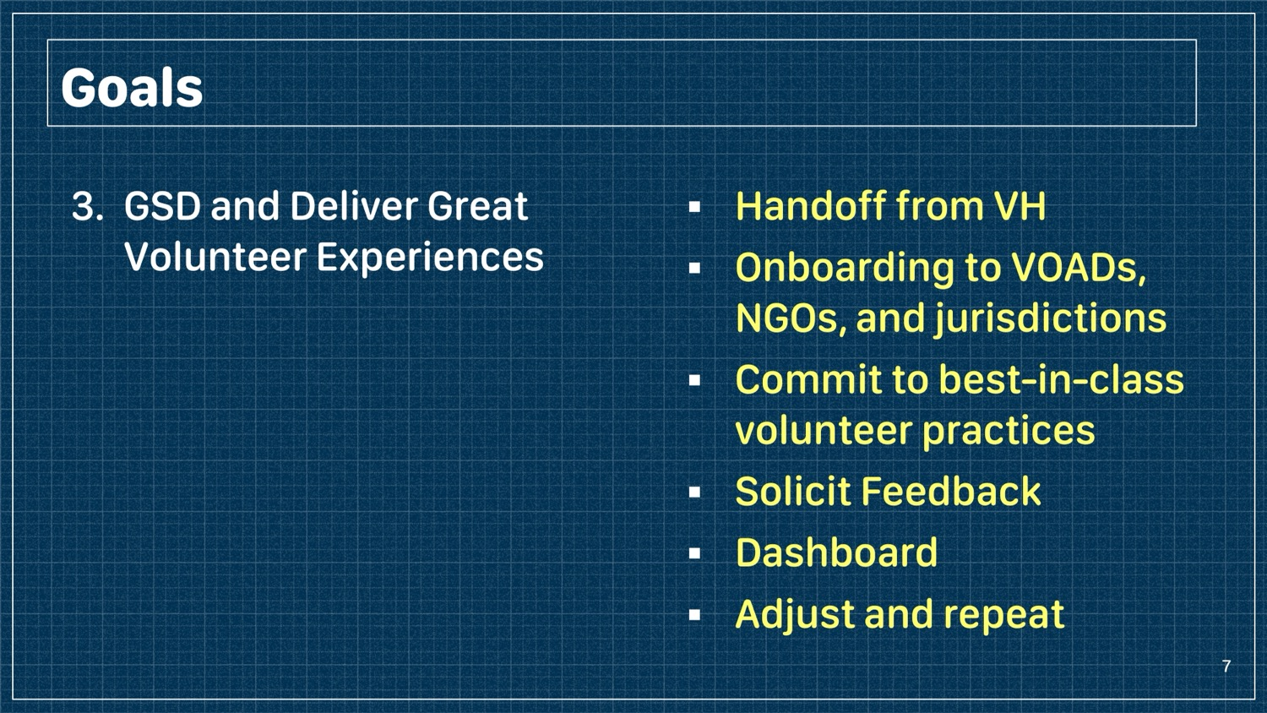
Goals
3. GSD and Deliver Great Volunteer Experiences
Handoff from VH
Onboarding to VOADs, NGOs, and jurisdictions
Commit to best-in-class volunteer practices
Solicit Feedback
Dashboard
Adjust and repeat

Slide 14
Discussion
Banner, Disaster Module, Filtering, Shifts, …
Follow up automation with a survey,
  Volunteers
  Agencies
Sandbox and testing
Management of Change
  Agencies, …
Volunteer Experience
Focus Group on Volunteer Experience
Leverage VOADs , & LTRCs

Slide 15
Goals
4. Build Capacity to Accept Unaffiliated Spontaneous Volunteers in the right locations
Solicit and train site leaders and establish processes at
  VOADs and NGOs
  Jurisdictions
Build resilient community resources
Direct VOADs and NGOs to the right locations

Slide 16
Capacity Building
Our deployment of Spontaneous Volunteers hinges on how many the VOADs, NGOs, and Jurisdictions can accept.
Established Standards and Practices, Recruit and Train
Training Civic Organizations, Unions, and the Faith Community to respond to
  Their Community, First Responders, Vulnerable
  Neighbors
  The larger Community

Slide 17
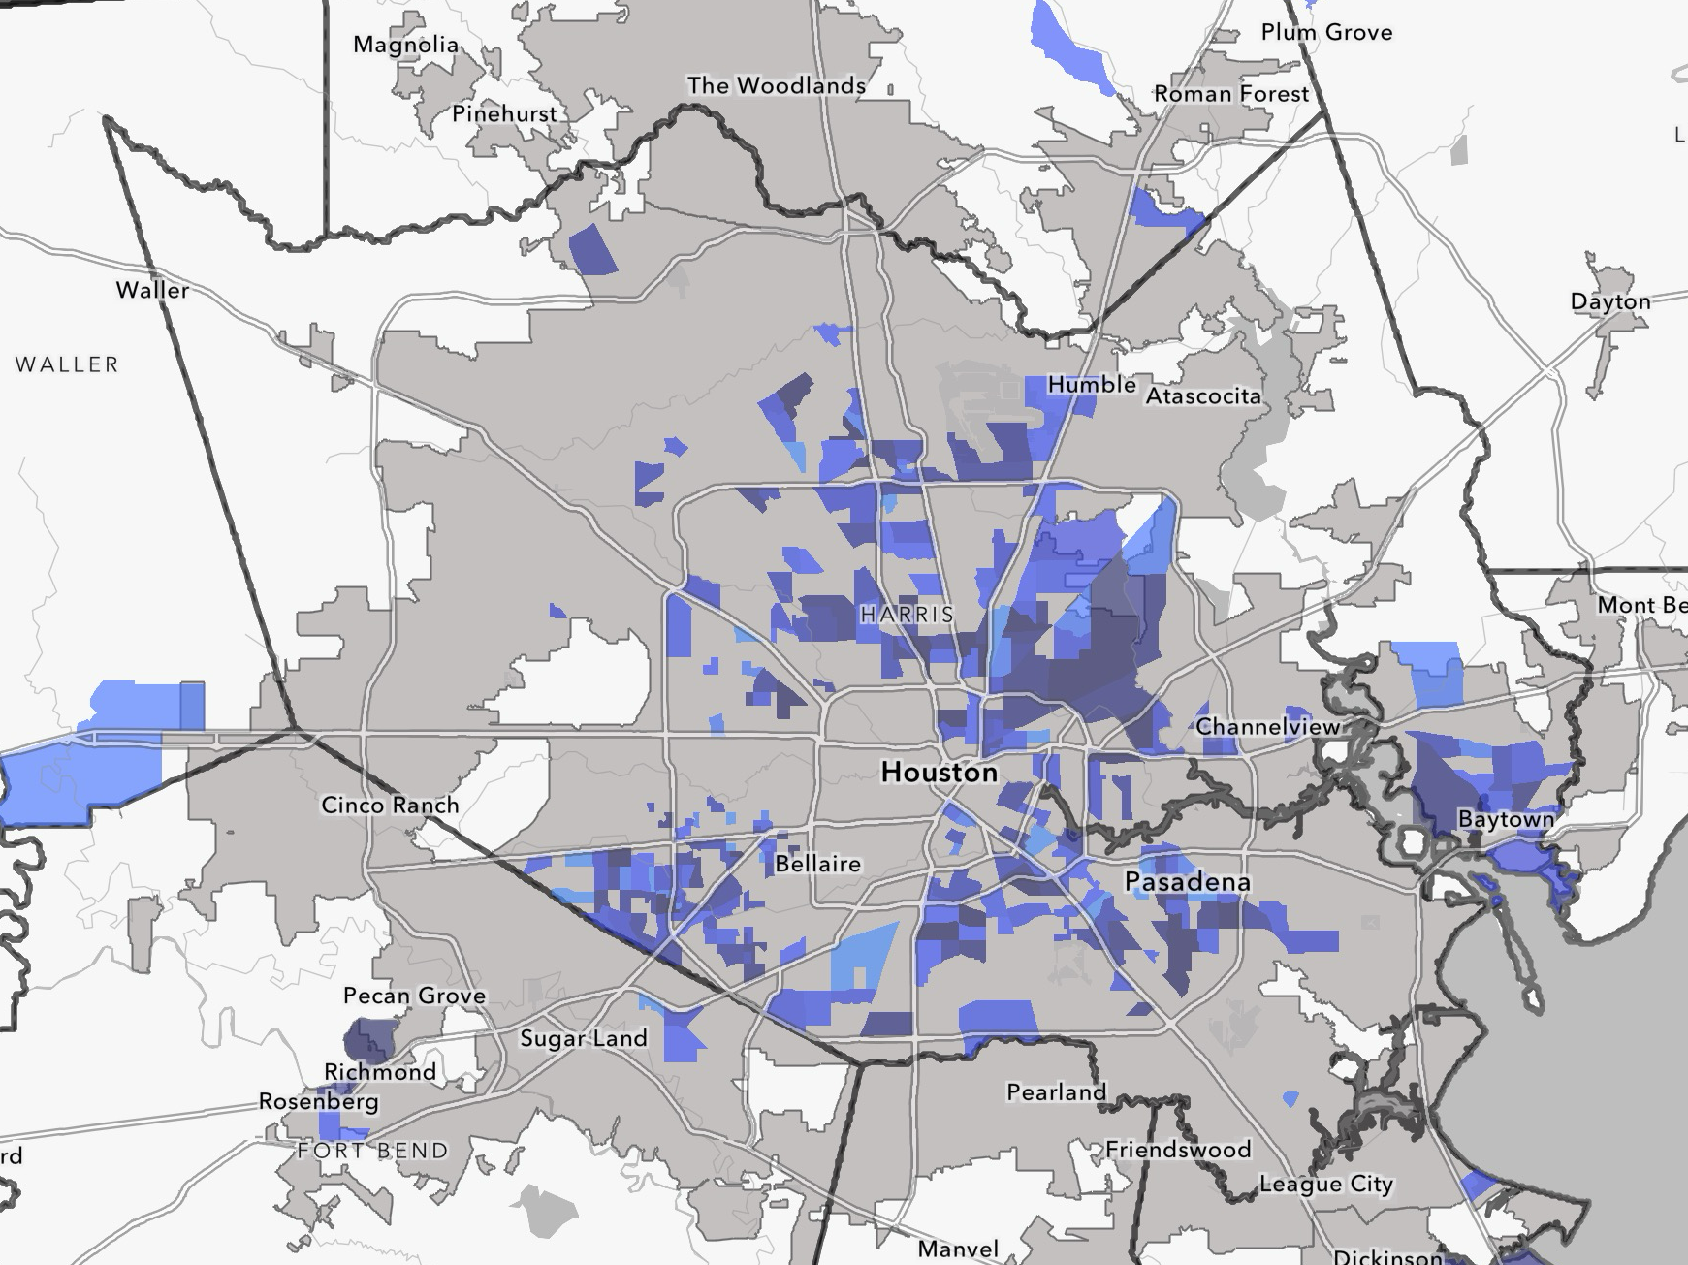
Addressing High SVI Communities

Slide 18
Addressing High SVI Communities
Hypothetical Tornado Tracks
Data:
NWS
iSTAT
Crisis Cleanup
Connective
Red Cross

Slide 19
Addressing High SVI Communities
Hypothetical Tornado Tracks
Data:
NWS
iSTAT
Crisis Cleanup
Connective
Red Cross

Slide 20
Addressing High SVI Communities
Scheduled Daily Coordination Call for All OEMs and TGCRVOAD to coordinate RFAs and VOAD/NGO placement
  Yellow box = most vulnerable families
Hypothetical Tornado Tracks
Data:
NWS
iSTAT
Crisis Cleanup
Connective
Red Cross

Slide 21
Discussion
Houston Ready
Points of Contact

Slide 22
Battle Rhythm
Committee Meetings
  End of February
  End of March
  End of April
  End of May
  Work Group Report Outs
Work Groups
  Meet as required – member(s) of the SC will likely attend
  Set Goals for March, April, and May
Steering Committee
  Build Bridges
  Resolve Gaps
  LT Sustainability

Slide 23
Next Steps
Steering Committee and Work Group Meetings
Monthly Reporting
  March
    Specific timetable for April and May
    Accomplishments
  April
  May

Slide 24
Next Meeting
March 26th
1:30-3:30
Harris County OEM?
(to be confirmed)

Slide 25





















THANK YOU!

